Slide 1
Segmenting Tumor Images to Study Immune Cells in Endometrial Cancer

Slide 2
Table of Content
Introduction & Background
Methods
Results
Discussion & Reflection
Questions

Slide 3
Introduction & Background
Clinical Context
What is MSI-H what are MSS/TMB-H & MSS/TMB-L
Why it’s important in the clinical context?
Hypothesis and Scope
What was the scope of the Project?
Notes:
Mechanisms of Response: The effectiveness of immunotherapy in TMB-H and MSI-H tumors relies on the generation of neoantigens (mutated peptides). These neoantigens are recognized as "non-self" by the immune system, triggering an infiltration of T-cells. The tumor protects itself by expressing PD-L1 (putting the "brakes" on T-cells); checkpoint inhibitors release these brakes
Relationship between TMB and MSI: While MSI-H tumors almost always have high TMB, not all TMB-H tumors are MSI-H. For instance, POLE-mutated tumors are often Microsatellite Stable (MSS) but possess an "ultra-mutated" phenotype (TMB >100 mut/Mb) due to defects in DNA proofreading, making them distinct from MSI-H but equally or more responsive to immunotherapy,,
.
• Discordance in Testing: While Next-Generation Sequencing (NGS) is used to determine TMB and MSI status, Immunohistochemistry (IHC) is the gold standard for detecting the underlying Mismatch Repair deficiency (dMMR). In endometrial cancer, NGS-identified MSI-H and IHC-identified dMMR are highly concordant in predicting the tumor immune microenvironment
.

Slide 4
Clinical Context
Endometrial cancer most common gynecological malignancy in developed countries
Mortality rates are steadily increasing (obesity, older age diabetes)
Early-stage is highly treatable with surgery, advanced cases however are limited → chemotherapy yields to poor long-term survival
EC has emerged as a primary candidate for immunotherapy because specific molecular subtypes of the disease are highly immunogenic (they provoke an immune response), making them susceptible to immune checkpoint inhibitors (ICIs)
Notes:
Endometrial cancer is the most common gynecological malignancy in high-income/developed countries. Unlike many other cancers where survival is improving, the incidence and mortality rates of EC are steadily increasing.
While early-stage EC is highly treatable with surgery, therapeutic options for advanced or recurrent cases are limited, and standard chemotherapy often yields poor long-term survival
.
• Immunotherapy Potential: EC has emerged as a primary candidate for immunotherapy because specific molecular subtypes of the disease are highly immunogenic (they provoke an immune response), making them susceptible to immune checkpoint inhibitors (ICIs) like pembrolizumab or dostarlimab

Slide 5
Molecular subtypes
Biomarker | Profile | Behavior | Mutation Count
MSI-H | Unstable | Hot Lots of Immune cells, good response | High 10-100 mut/Mb
MSS/TMB-L | Stable | Cold Low mutation | Low < 10 mut/Mb
MSS/TMB-H | Stable Lots of neoantigens, robust immune cell infiltration |  | Ultra-high >100 mut/Mb
Notes:
Molecular Drivers of TMB: High TMB in EC is primarily driven by two distinct molecular defects:
1. POLE Mutations (Ultra-mutated): Mutations in the POLE gene (specifically the exonuclease domain) destroy the cell's DNA proofreading capability. This results in an "ultra-mutated" phenotype with a TMB often exceeding 100 mutations/Mb
.
2. Mismatch Repair Deficiency (MMRd/MSI-H): Defects in DNA mismatch repair proteins lead to a "hypermutated" phenotype (typically 10–100 mutations/Mb)
.
• Mechanism of Action: These high mutation rates lead to the production of neoantigens (abnormal proteins on the tumor surface). These neoantigens are recognized as "foreign" by the immune system, leading to a strong infiltration of CD8+ cytotoxic T-cells
.
• Therapeutic Implication: Because TMB-H tumors are already filled with immune cells attempting to attack the neoantigens, they are "hot" tumors. However, they protect themselves by expressing immune checkpoints (like PD-L1). Using inhibitors to block these checkpoints unleashes the pre-existing immune cells to kill the cancer. Consequently, high TMB has become an FDA-approved biomarker for prescribing pembrolizumab in EC

Slide 6
Scope of the Project
Analyze immune cell within MSS/TMB-H
Generate high- resolution spatial maps of Immune cells
Quantify densities and identify unique spatial patterns.
Create a Machine Learning model which classifies the Molecular subgroups
Notes:
Analyze immune cell within MSS/TMB-H
Generate high- resolution spatial maps of Immune cells
Quantify densities and identify unique spatial patterns.
Create a Machine Learning model which classifies the Molecular subgroups

Slide 7
Methods
Dataset from TCGA (514 cases, 320 TMB-L , 163 MSI-H, 31 TMB-H
The DL Pipeline (HoVer-NeXt)
Extension of HoVer-Net
Faster as the HoVer-Net
Hovernet (predicts the horizontal & vertical distances of nuclear pixels to their centers of mass)
17X faster as the Standard of HoVer-Net Architecture

Slide 8
Methodlogical Workflow
Dataset
Hovernext
Heatmap / CSV
Exploratory Analysis
ML
UMAP

Slide 9
Machine Learning
Class prediction
Used PCA to create a robust model
3 Imbalance strategies
SMOTE
SMOTE-TOMEK
Class weightening
4 Models tested
Multinominal Logistic Regression
Random Forest
XGBoost
Multilayer Perceptron

Slide 10
Results
Spatial Heatmaps
Show the heatmaps
Violin plots and statistical analysis
Classification of ML
Confusion matrix /
UMAP

Slide 11
Discussion & Reflection
Interpretation of the results
Limitations
Limited dataset
HPC

Slide 12
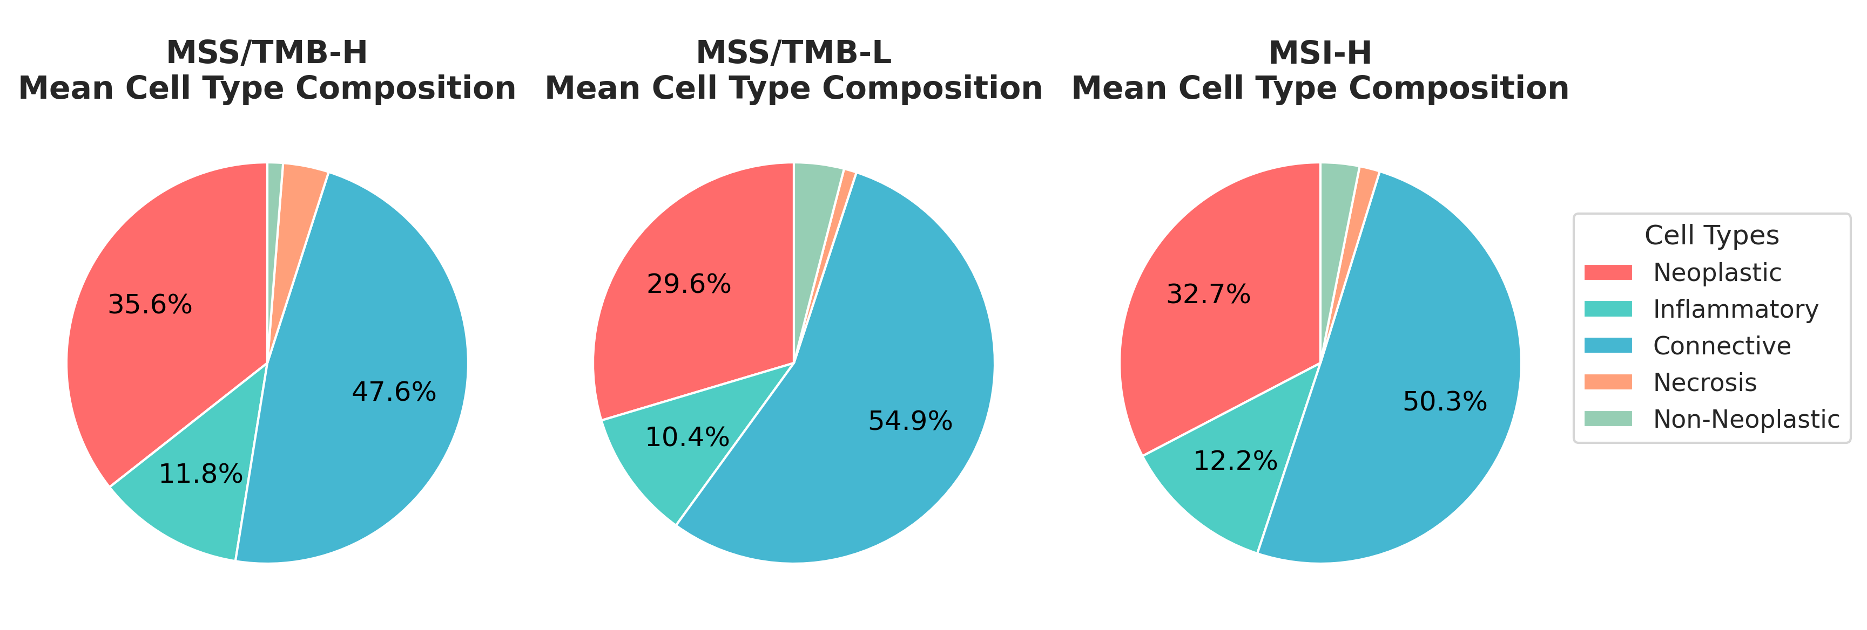
Cellular composition

Slide 13
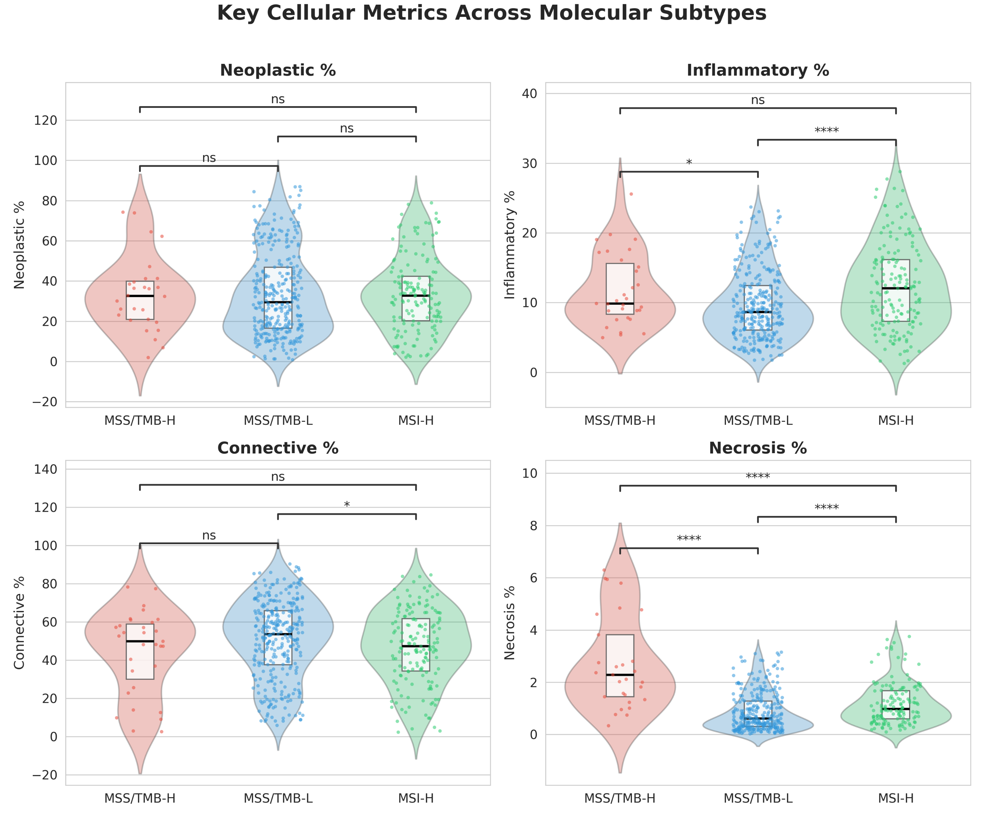
Violin Plots
Statistical tests done with Kruskal Wallis
Modest variation between groups
MSI-H has highest infiltration MSS/TMB-H is intermediate
Necrosis strongest discriminator.
MSS/TMB-H shows highest Necrosis

Slide 14
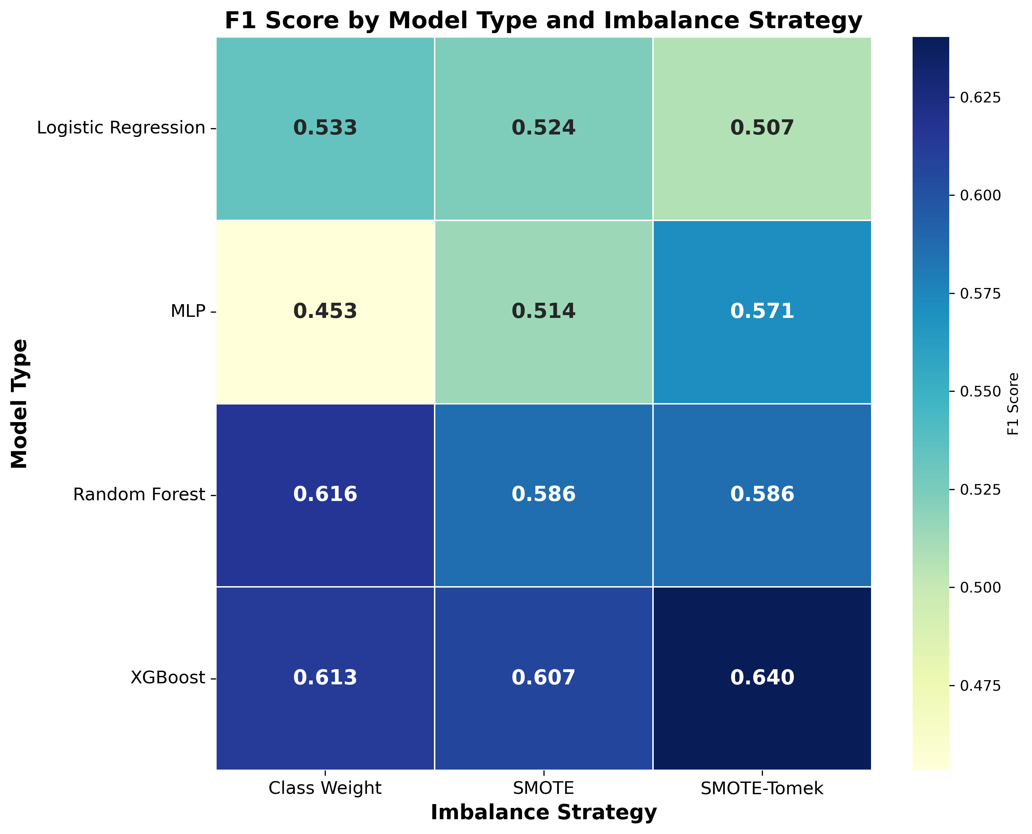
ML
12 Models
XGBoost with SMOTE-TOMEK
Random Forest with Class weight

Slide 15
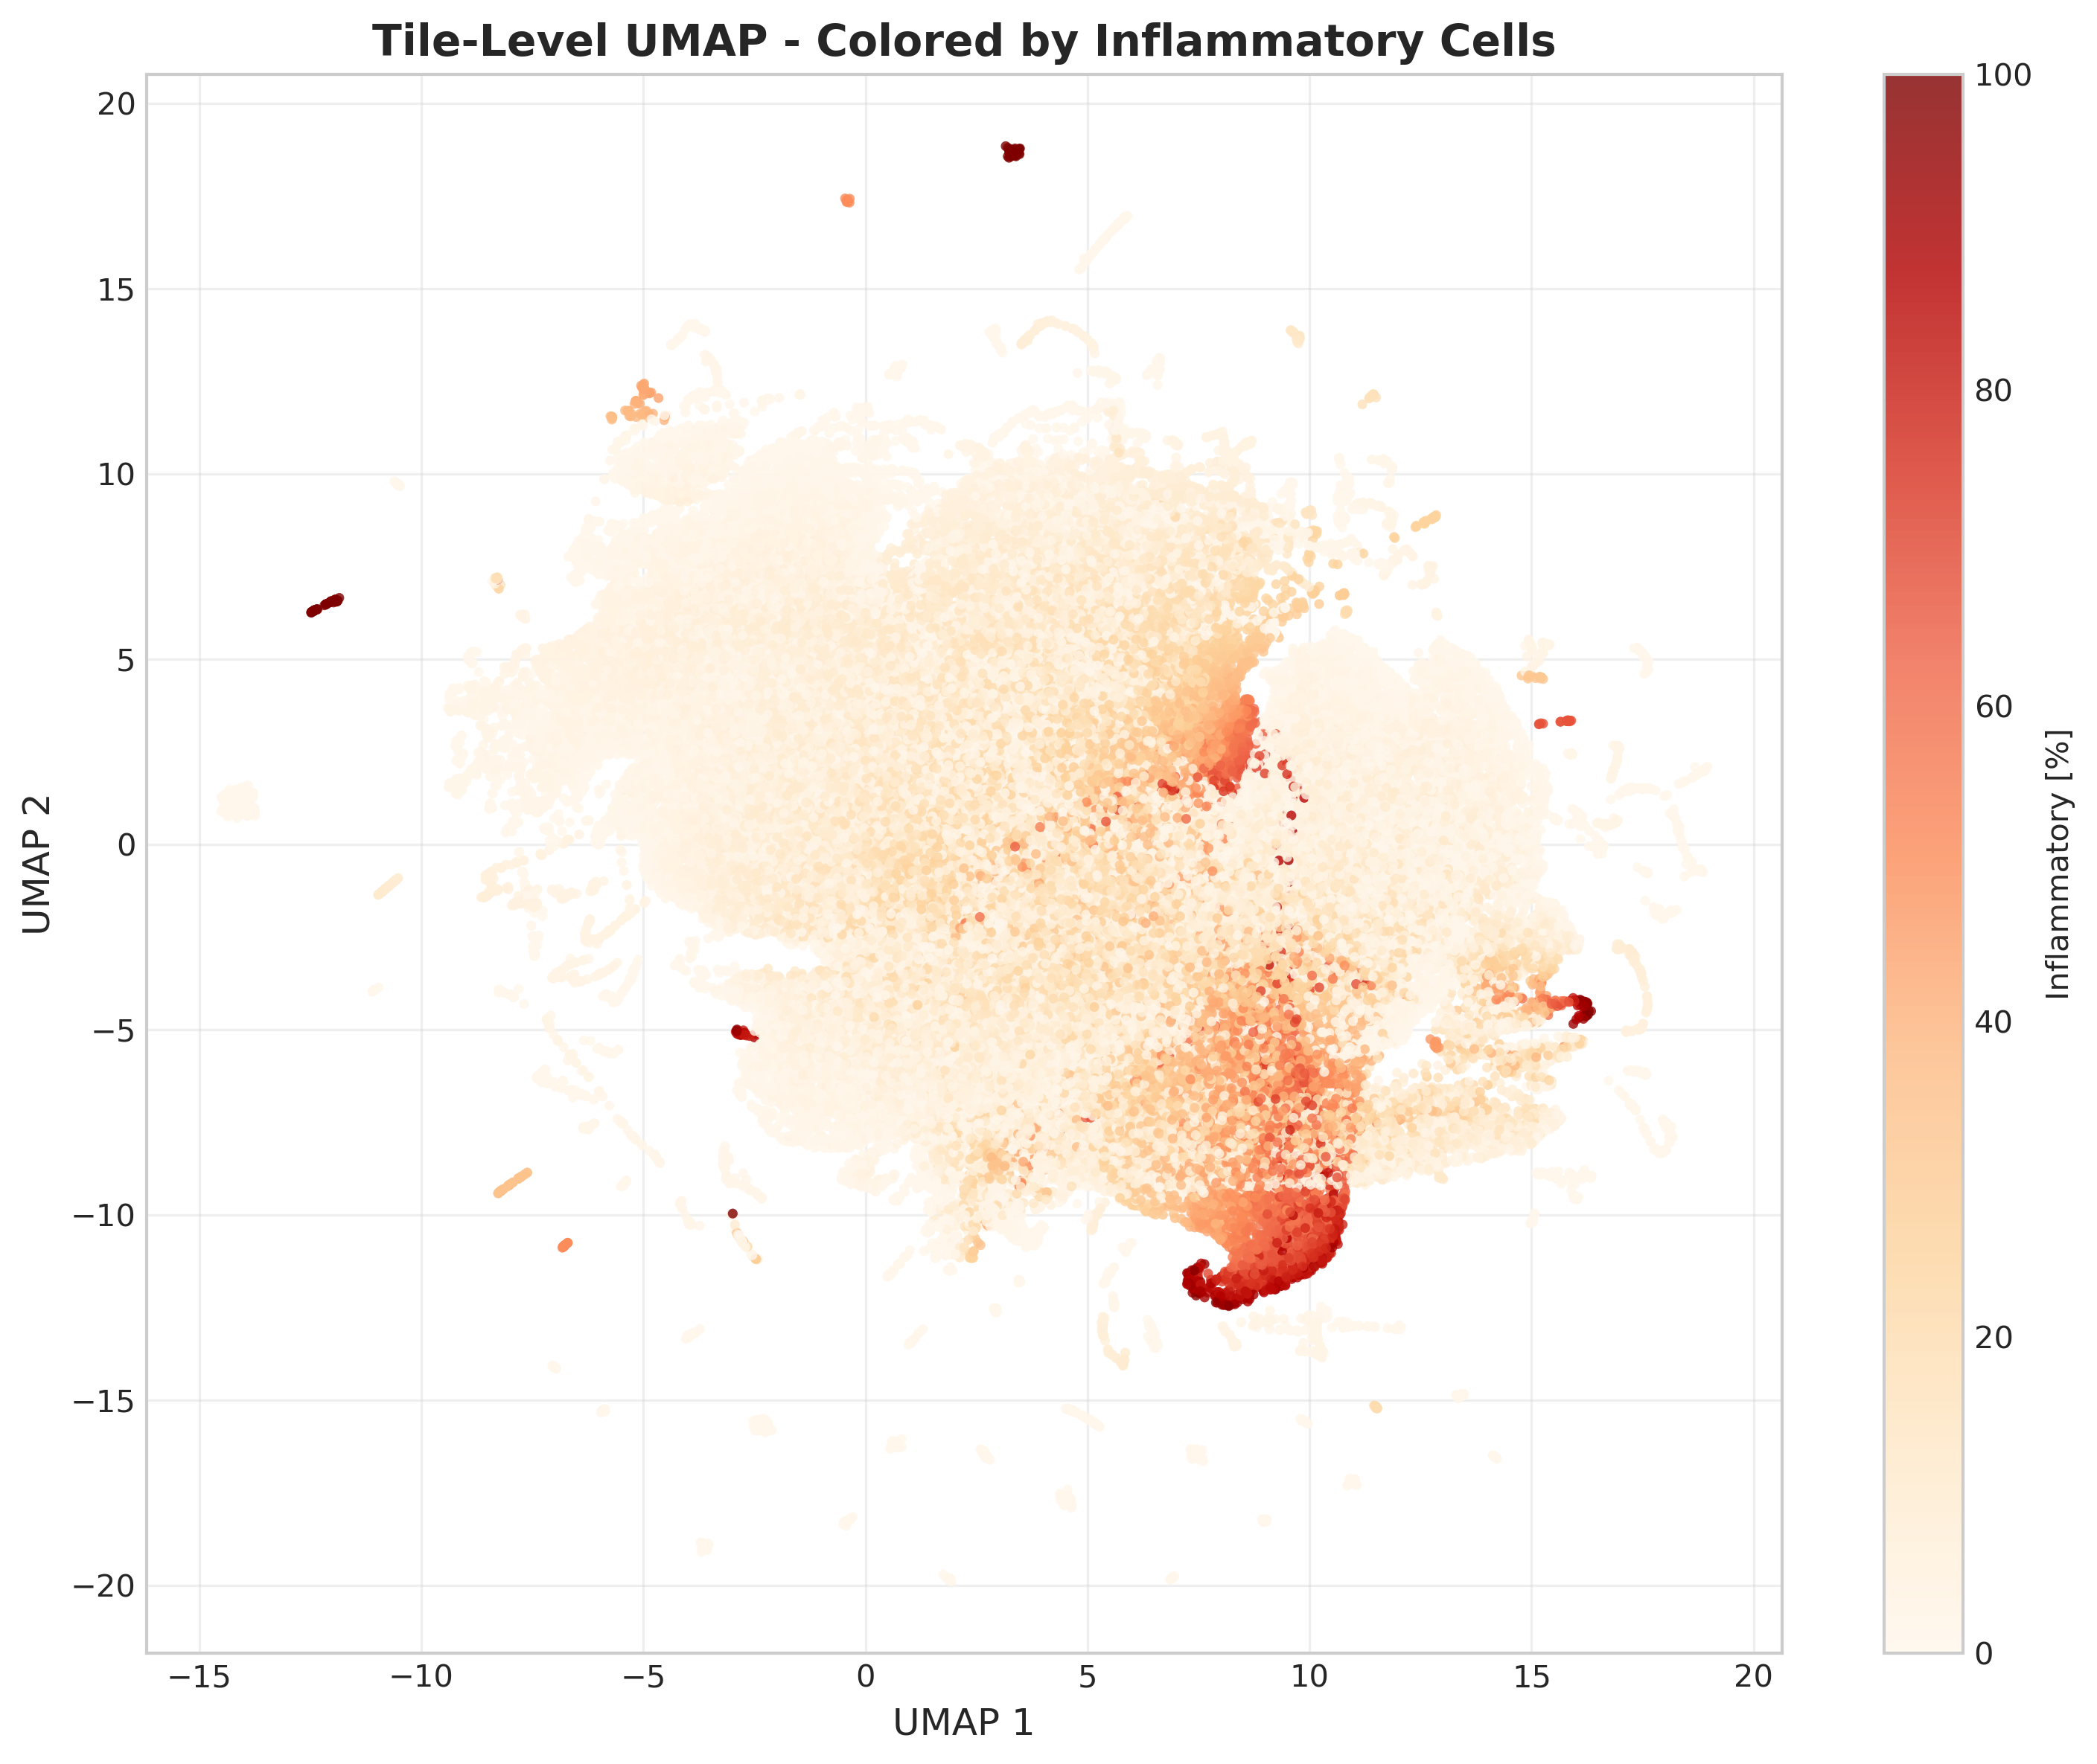
UMAP
More to see in the Discussion

Slide 16
Limitations
Class imbalance
No Cell-To-Cell interactions
Need for higher quality data and more dat
Additionally, as mentioned in the methods, my analysis focused on mapping distributions. I did not perform quantitative interaction analysis, such as measuring the exact distances between immune and tumor cells.

Slide 17
Summary
The "Diffuse" Phenotype: MSS/TMB-H is a distinct microenvironmental entity, not just a midpoint¹¹¹¹¹¹¹¹¹.
Unlike MSI-H (Hotspots) or MSS/TMB-L (Cold)².
Suggests immune cells are abundant but "trapped" in the stroma (Immune-Excluded)³³³³.
Decoupling of Metrics: In MSS/TMB-H, inflammatory percentage does not correlate with density⁴⁴⁴⁴.
Necrosis: High neoplastic cell abundance and irregular necrosis contribute to structural heterogeneity⁵.
Classification Overlap: The model often confuses MSS/TMB-H with MSI-H, suggesting they share "immunogenic" traits despite different genetics⁶.
Notes:
A checklist or a "Roadmap" graphic (Current Study $\rightarrow$ Future Work).
Key Bullet Points (for the slide):
Sample Size: Small cohort for the target group ($n=31$) limits definitive clinical conclusions¹¹¹¹¹¹¹¹.
Class Imbalance: Required aggressive synthetic oversampling (SMOTE), which impacts model decision boundaries¹²¹²¹²¹².
Scope of Analysis: Focused on cell distribution; did not include cell-cell interaction graphs or gene expression¹³.
Future Work:
Validation on larger, multi-institutional cohorts¹⁴¹⁴¹⁴.
Integration of graph-based metrics (e.g., K-nearest neighbors) to quantify "neighborhoods"¹⁵.
Spoken Script (What to say):
"It is important to acknowledge the limitations of this exploratory study. The most significant constraint was the sample size—with only 31 MSS/TMB-H cases, statistical power was limited, and we had to rely heavily on synthetic oversampling to train our models¹⁶.
Additionally, as mentioned in the methods, my analysis focused on mapping distributions. I did not perform quantitative interaction analysis, such as measuring the exact distances between immune and tumor cells¹⁷.
Therefore, future work should focus on two things: first, validating these findings in a much larger cohort to ensure clinical reliability¹⁸. Second, moving from heatmaps to graph-based metrics to mathematically model the cellular neighborhoods we observed¹⁹."

Slide 18
Questions?

